Slide 1
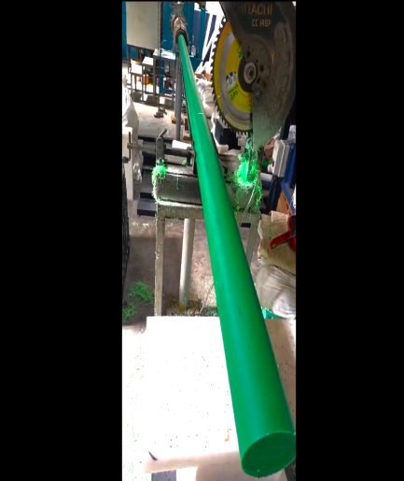
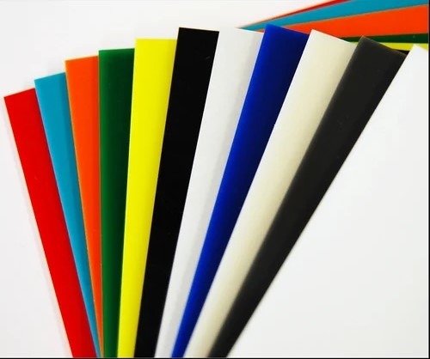
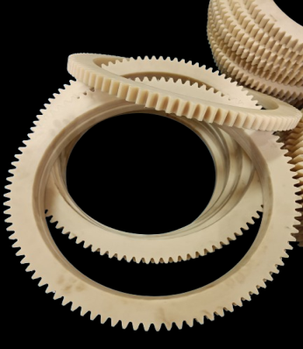
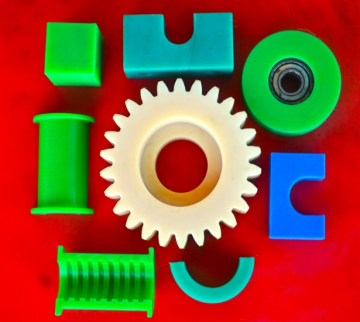
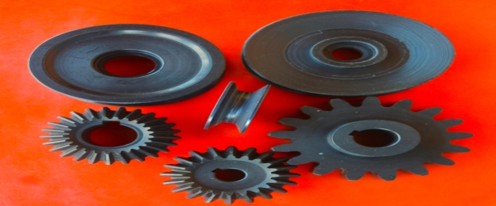
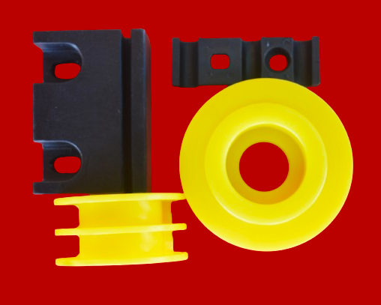
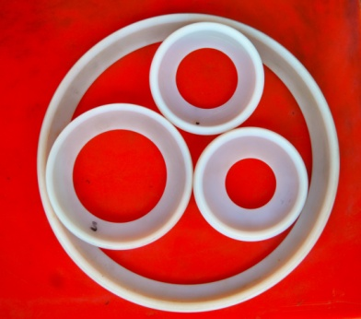
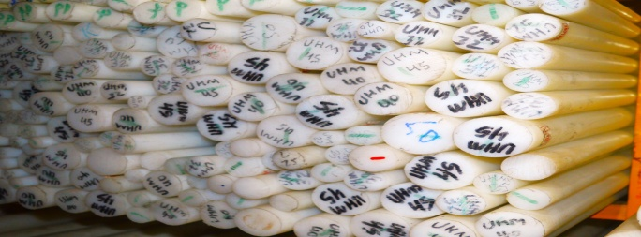
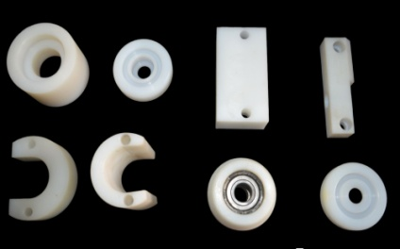
Welcome to Truston Polymers & Engineering Components Truston Polymers is engaged in manufacturing, Processing and Design Polymer rods, Sheets, high-performance Components & profiles. We also stocks wide range of Engineering Plastic Products to meet the requirements of our customers.
TRUSTON was established in 2017 as a partnership firm to serve quality Polymers & customized products to boost the thrust of engineering growth. Three decades of experience & technical expertise in the Polymer processing industry helps us to identify perfect material combination for each application.
Truston committed to provide the best service and the best products to our customers.
The high-performing Engineering Plastics are used in numerous industrial applications including,
Improve safety.
Resist abrasion, impact & corrosion.
Reduce cost and weight.
Increase colour options without painting.

Slide 2
OUR PRODUCTS
Stock material
we offer Polymer rods and sheets of various sizes and colours as per requirement
(photos of rods and sheets
Machined Components
We offer wide range of machined polymer parts and components
( Photos of components)
UHMW-PE
NYLON
Delrin
PP
Teflon
FRP
(With features and application)
Benefits of Engineering Plastics
High resistance to Abrasion, Corrosion, wear, Impact, Chemical, fatigue, Heat, Fire
Low maintenance, coefficient of friction, wear, moisture absorption,
Design flexibility (colours, textures)
Lightweight
Low Noise and vibration
Lower cost than traditional materials
Better sealing performance
Easier to fabricate, machining, ship & install
Self-lubricating,
High pressure/velocity performance
Stable and rigid

Slide 3
Products as per your requirement such as Bars, Bearings, Belt scrapers, Blocks, Bushes, Bushings and Bearings, Conveyor Parts, Couplers, Customised Profiles & Components, Cutting boards, Dies for Papad & Chappathi, Dock fenders & bumpers, Dump truck and Trailer liners, Facing Pads, Fasteners, Feeder tubes, Gaskets, Gears, Grips, Guards and Fenders, Guide rails, Guides, Idlers, Impact pads, Impellers, Inserts, Liners, Marine seating, Pallets, Panels, Pipes, Plates, Profiles, Protectors, Pulleys and Sheaves, Resting pads, Rods, Rollers, Saddle Pads, Scraper blades, Seals, Sheets, Skid plates, Spacers, Spades, Spares, Sprockets, Stopper Pads, Strips, Switch board panels, Tanks, Tensioners, tooth locks, Trays and tray tables, Trolly wheels, Truck beds, Truck Liners, Tubing, Washers, Wear Plates, Wear Strips & Pads, Wheels,..
Stocks various size Rods & Sheets of
ACETAL, ACRYLIC, DELRIN, HDPE, HMW,HYLAM, LDPE, NYLON, PEEK, PEI, PET, POLY CARBONATE, Polyethylene(PE), POLYPROPYELENE(PP), POM, PPO, PSU, PTFE, PU, PVC,PVDF, PFA, TEFLON, UHMW-PE, ..
TRUSTON has a list of CUSTOMISED portfolios manufactured for various companies.
Aerospace, Agriculture, Agro, Automative, Building & Construction, Ceramic, Chemical, Construction, Conveyor lines, Distilleries & Beverages, Food processing companies, Heavy Equipment Industries, Heavy Industries, Machine/ Tire manufacturers, Marine, Material Handling, medical equipment, Mining, Sugar, Oil & Gas, Pharma, Pulp & Paper, Sports & Recreation, Sugar, Tire manufacturers, Transport, Water & Wastewater Treatment plants, …
TRUSTON provides customized solutions for moulded & machined components from simple washers to complex assembled parts, with metallic combination, Metallic to Non-Metallic conversion, Material upgradation, Weight reduction, …..
With vast experience in adhesive and polymer manufacturing, we are committed to provide the best quality products possible to our customers.

